Slide 1
TransLingua: Al-Powered Multi-Language Translator
Team Bolbhasha:
M.Srija
K.Preethika
L.Pavithra
K.Sirisha

Slide 2
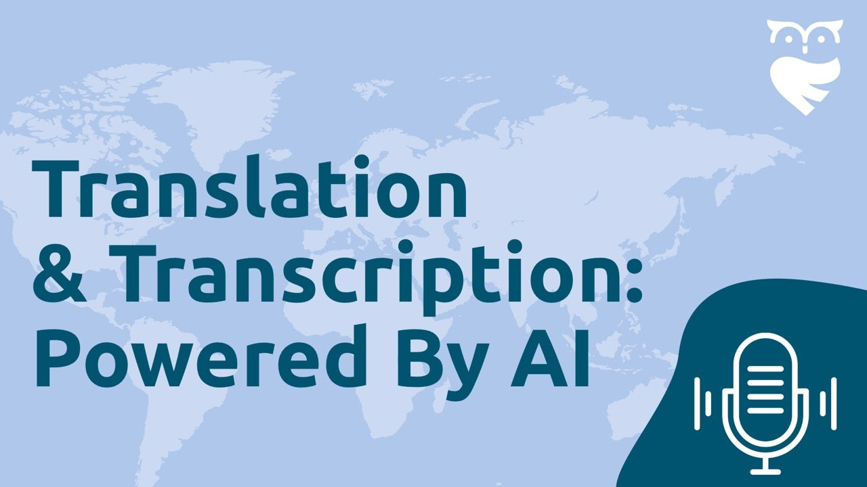
Introduction to TransLingua
TransLingua is an advanced AI-powered multi-language translator designed for seamless communication.
It utilizes state-of-the-art machine learning algorithms to deliver accurate translations across numerous languages.
Its user-friendly interface makes it accessible for both casual users and professionals alike.

Slide 3
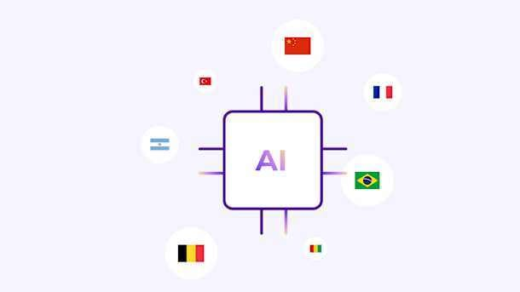
Key Features
TransLingua supports over 100 languages, ensuring broad global communication capabilities.
The platform offers real-time translation, allowing users to engage in live conversations effortlessly.
Advanced context recognition helps maintain the nuance and tone of the original message during translation.

Slide 4

AI and Machine Learning Integration
The translator employs deep learning models that continuously improve translation accuracy.
By analyzing vast amounts of linguistic data, TransLingua adapts to language evolution and trends.
This AI-driven approach ensures that users receive the most relevant translations tailored to their needs.

Slide 5
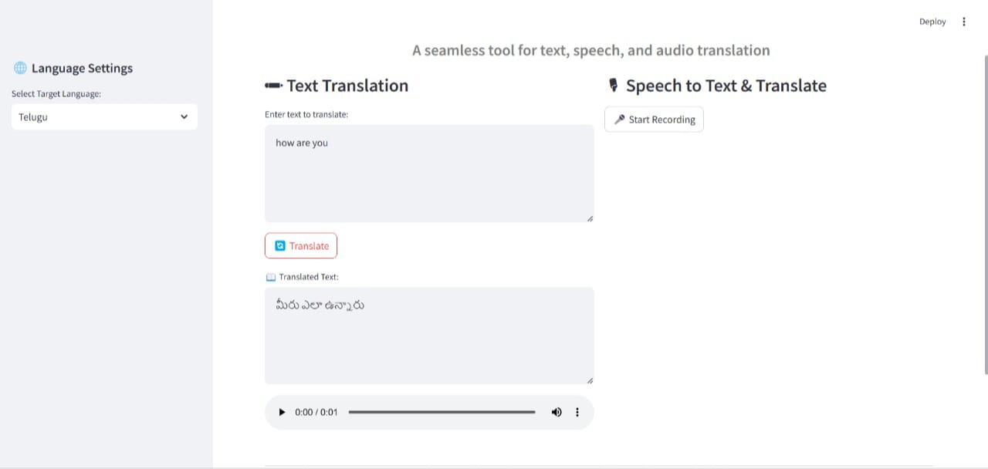
User Experience and Interface
TransLingua features an intuitive interface that simplifies the translation process for all users.
Users can easily switch between languages .
The platform is designed to minimize user input while maximizing output efficiency.

Slide 6
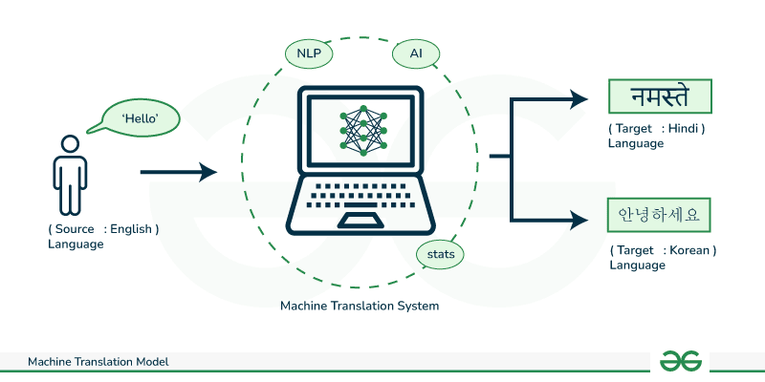
Applications in Business
Businesses can leverage TransLingua for effective communication with international clients and partners.
The translator streamlines the localization of marketing materials and product information.
Enhanced communication fosters better collaboration and reduces the risk of misinterpretation.

Slide 7
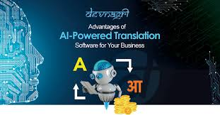
Educational Benefits
TransLingua serves as a valuable tool for language learners seeking to practice and improve their skills.
Students can use the platform for homework help, translating texts and understanding foreign languages.
Educators can integrate TransLingua into their teaching methods to enhance language acquisition.

Slide 8

Security and Privacy
TransLingua prioritizes user privacy by employing encryption protocols to secure data transmission.
User-generated content is not stored or used for training models without explicit consent.
The platform adheres to international data protection regulations to ensure compliance and trust.

Slide 9

Conclusion
TransLingua is revolutionizing the way we communicate across languages in an increasingly globalized world.
With its powerful AI technology, it bridges linguistic gaps and fosters understanding among diverse cultures.
Discover the benefits of TransLingua today and enhance your communication experiences!

